Slide 1
ML Workshop 25th Feb 2020
By:
Raj Dhyani (rddhyani@gmail.com)
JBIMS(MMS 1985-87), IIT Bombay (B Tech-1984),Pg(IITB-cse dept-ML,BlockChain)(2017-19)
Prashant K. Sharma (prashaantsharmaa@gmail.com)
AI Researcher (Published)
Hitachi RnD | IIT Bombay

Slide 2
What can Deep Learning do ?
https://youtu.be/W8fsJJftYN8
Notes:
McKinsey Analytics: What can deep learning do for your business?

Slide 3
Why Data Scientist become sought after profession
HBR October 2012 article
“Data Scientist: The Sexiest Job of the 21st Century “
by Thomas Davenport and DJ Patil
https://hbr.org/2012/10/data-scientist-the-sexiest-job-of-the-21st-century

Slide 4
Growing Impact of AI
Credit Decisions
Bringing AI on board cut losses by US automobile lending companies
by 23%.
Fraud Prevention

Slide 5
Artificial Intelligence-Definition
According to the father of Artificial Intelligence,
John McCarthy, AI is
“The science and engineering of making
intelligent machines,
especially intelligent computer programs”.
He coined the term Artificial Intelligence in 1956

Slide 6
AI
Artificial Intelligence is a way of making
a computer,
a computer-controlled robot, or
a software think intelligently,
in the similar manner the intelligent humans think.

Slide 7
Goals of AI
To Create Expert Systems
To implement Human Intelligence in Machines

Slide 8
Why go for AI now
IBM Deep Blue the chess program by IBM beats the then World Chess
Champion Garry Kasparov in May 1997,who had bragged that he
would never lose to a machine.
IBM Watson beats Ken Jennings and Brad Rutters the two greatest US Jeopardy’s champions in 2011
Notes:
Both breakthrough are because of Games(ie Chess+Jeopardy)
Machine learning/Ai would make the present MBA students “Future ready”

Slide 9
Application of AI in Education
Data powered by AI can change how educational institutes
Find, Teach and support Students
Educational Institute selection process may end up like
Amazon
Netflix
recommending the best courses for students in a customized
manner

Slide 10
Machine Learning models
Decision Trees
Random Forest
XGboost
SVC/SVR
Naive Bayes
Logistic Regression

Slide 11
Decision Trees

Slide 12
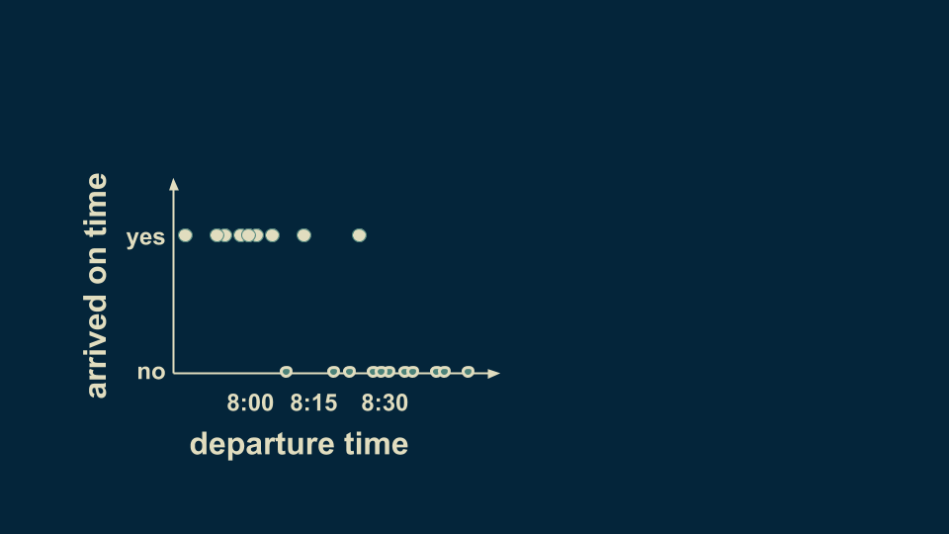
A simple Decision Tree
Consider a dataset: Recording time of leaving the house, note whether you arrive on work on time.

Slide 13
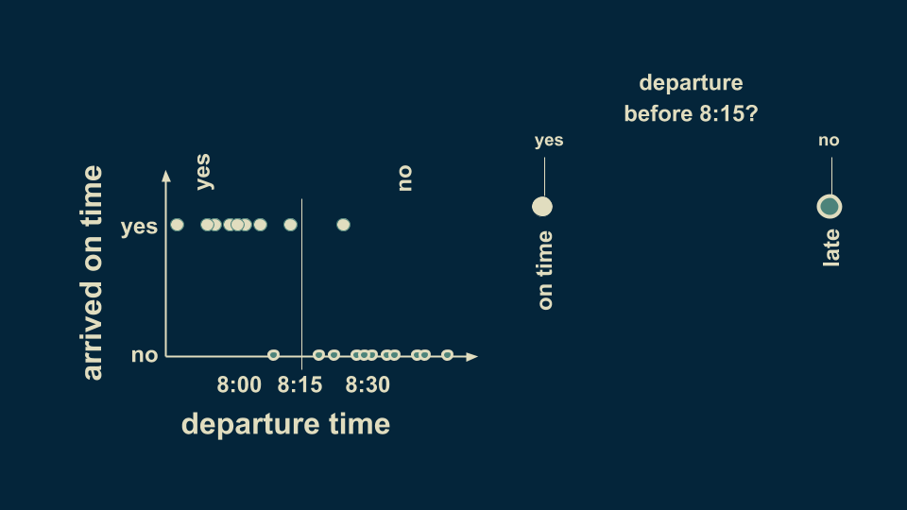

Slide 14
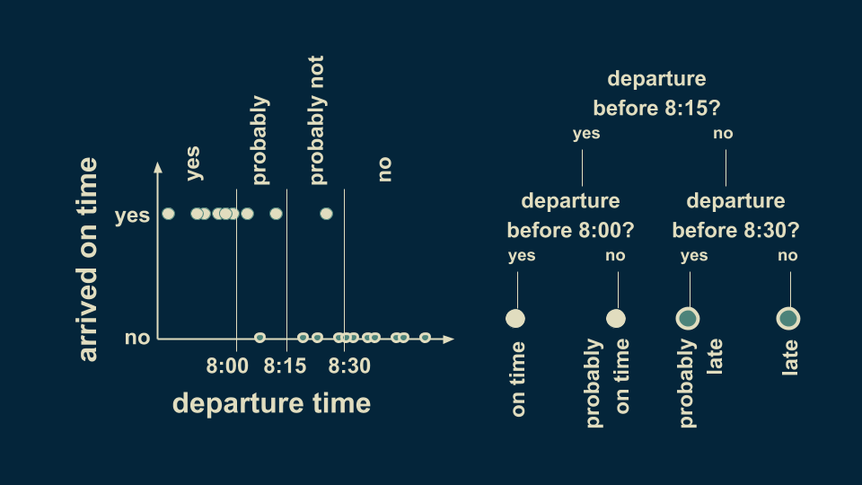

Slide 15
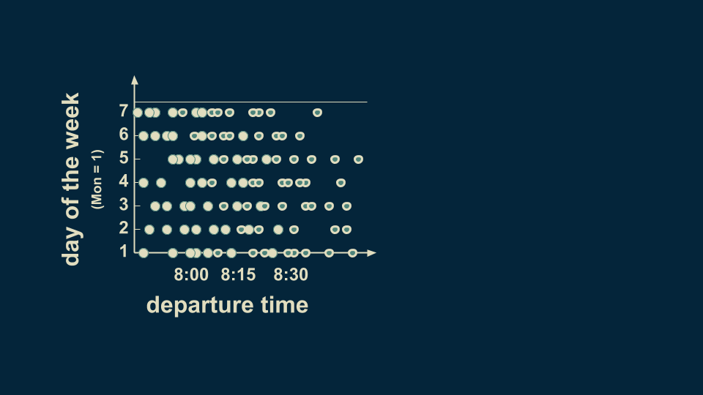
Decision Tree: Consider two variables/features
Consider:
Departure time
Day of week
Monday =1 , Saturday = 7

Slide 16
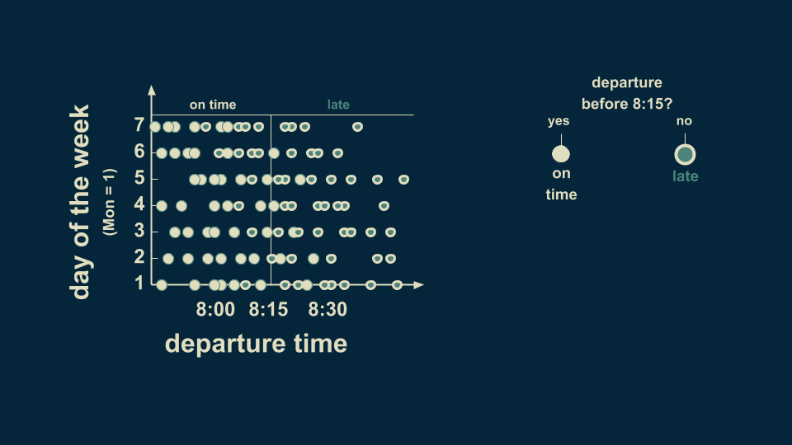

Slide 17
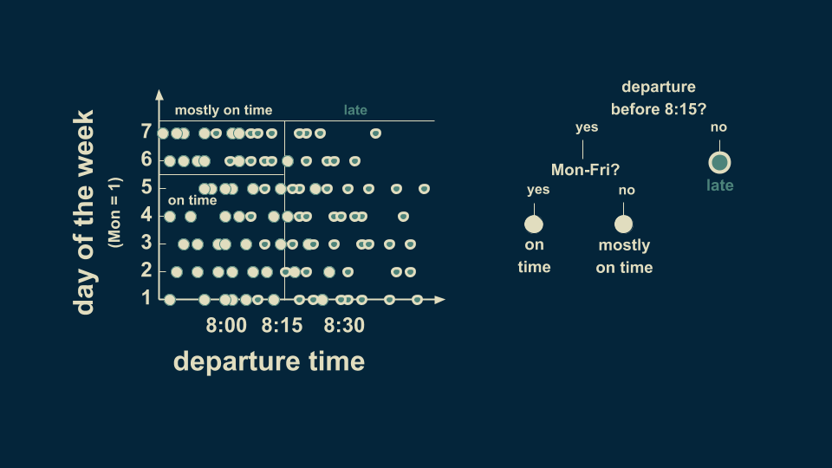

Slide 18
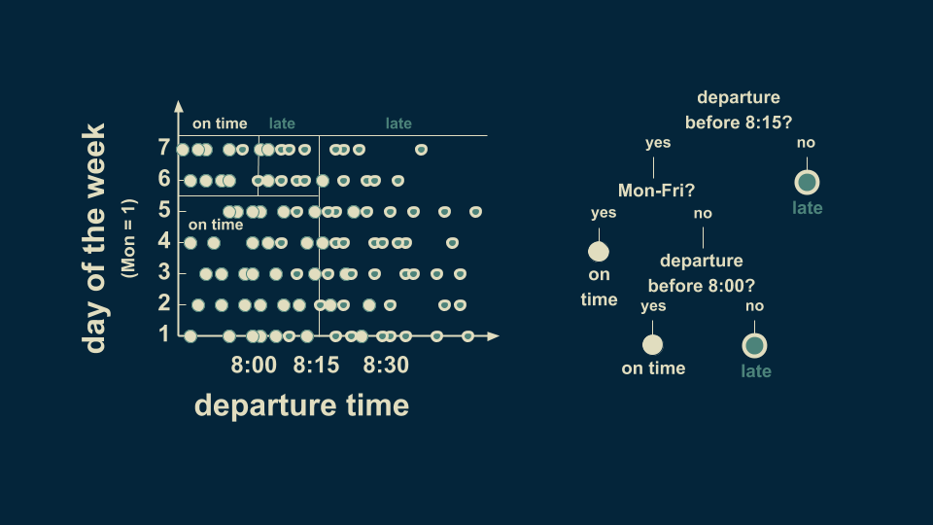

Slide 19
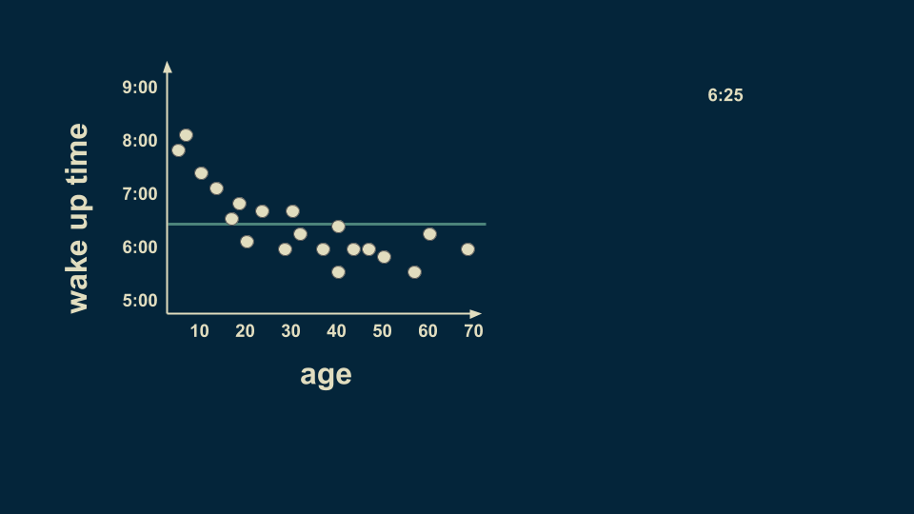
Decision Tree: Continuous Variable/Regression Tree
The root of regression tree is estimate for the entire dataset.

Slide 20
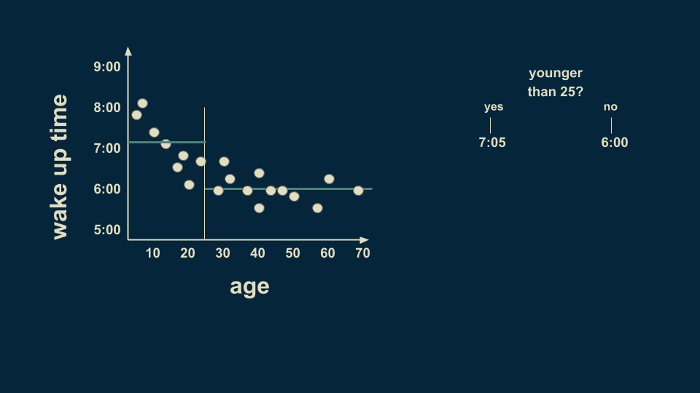
Notes:
A reasonable first split is at age 25. On average, people younger than 25 wake up at 7:05 and people older than 25 wake up at 6:00. To counter for the variation, we split again ...

Slide 21
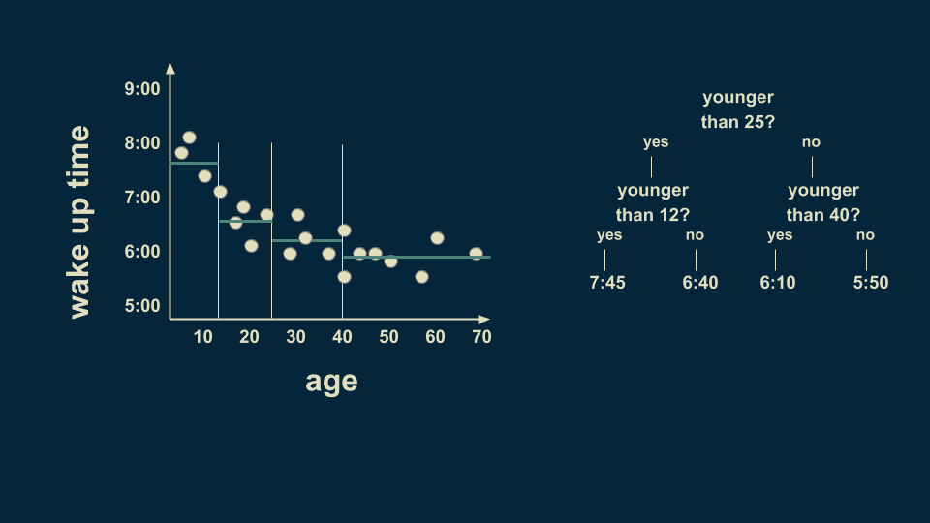
Notes:
The over 25 group can be meaningfully subdivided too. Those between 25 and 40 wake up on average at 6:10 and those between 40 and 70 wake up on average at 5:50.

Slide 22
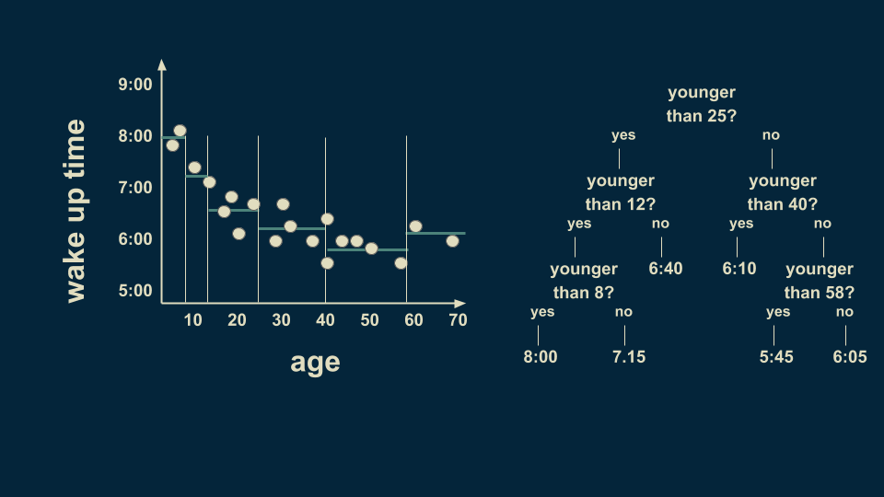
Notes:
There is still a lot of variation in the youngest group so we can further subdivide it. By slicing again on age 8, we can refine the estimates to more closely fit the data. We can also subdivide the 40 to 70 group on the 58 year line. Notice that we are getting to where we only have one or two data points in some of the leaves of our tree. This is a dangerous condition and can lead to overfitting

Slide 23
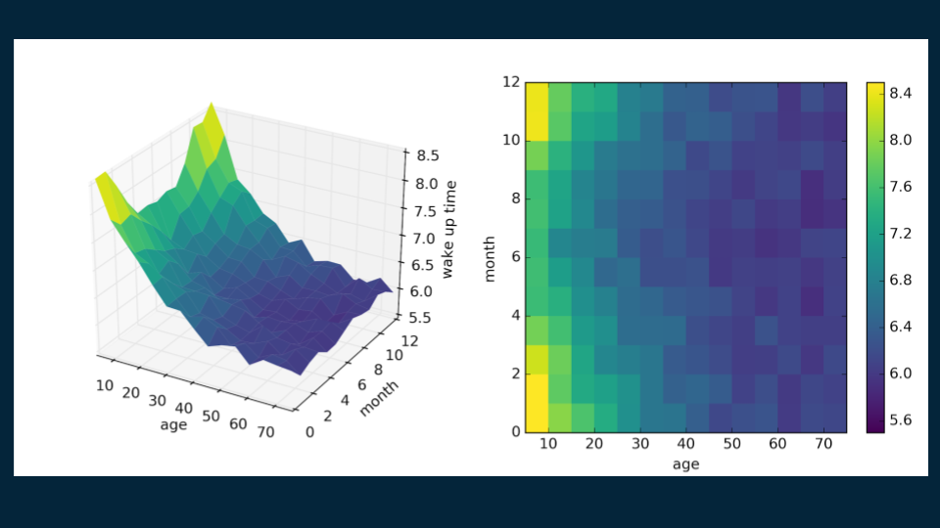
Decision Tree: 2 Variable Regression Tree
If we consider not only someone’s age, but the month of the year as well, then we can find even richer patterns

Slide 24
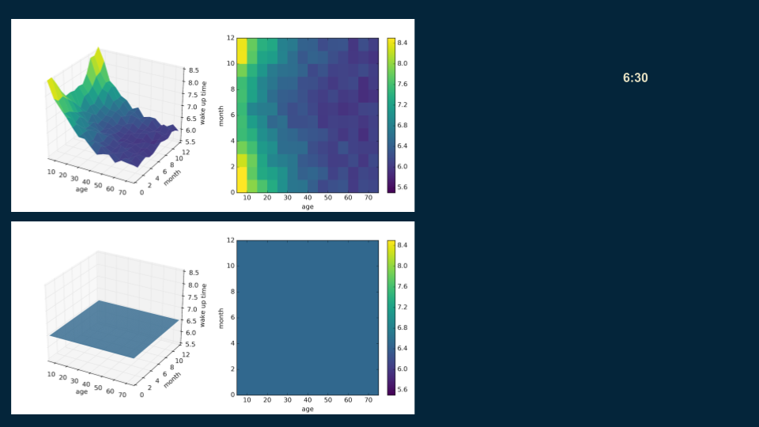
Notes:
We start with the root, a single estimate that roughly fits the entire data set: 6:30

Slide 25
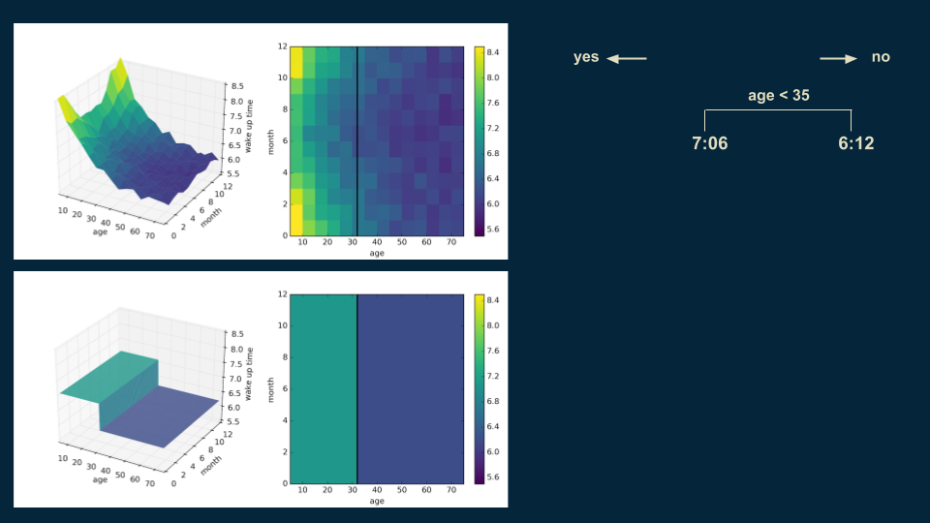
Notes:
Then, we look for a good place to put a decision boundary. We split the data on age 35, creating two halves, one for our under 35 population with a wake up time of 7:06, and one for over 35 population with a wake up time of 6:12.

Slide 26
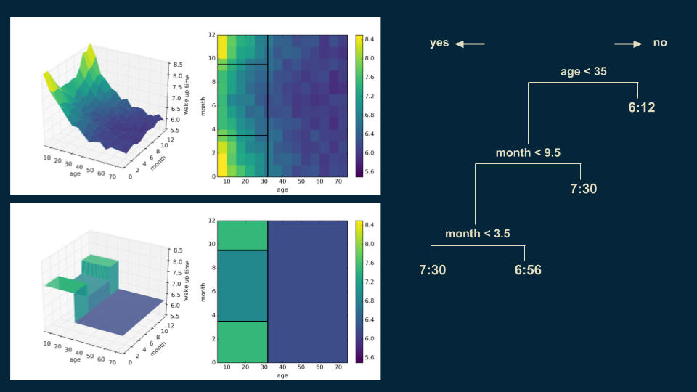
Notes:
repeat the process, subdividing our younger population on whether it is before or after the middle of September and whether it is before or after the middle of March. This isolates the winter months from the summer months. Winter months have a wake up time of 7:30 for those under 35, and in the summer months it is 6:56.

Slide 27
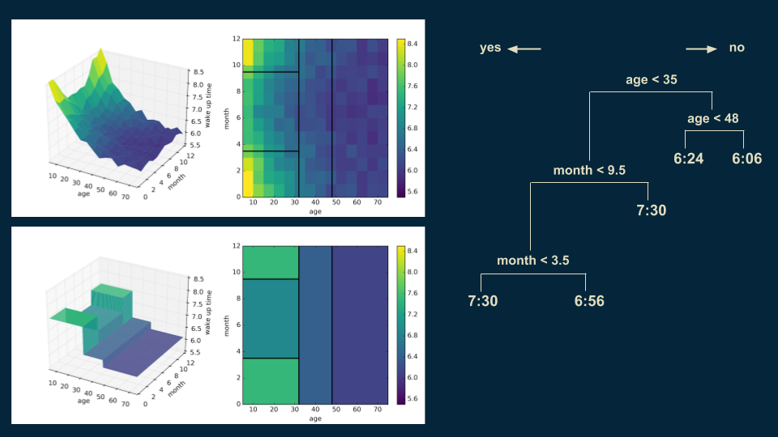
Notes:
we can revisit our over 35 population and split them again on age 48 to get a more accurate representation.

Slide 28
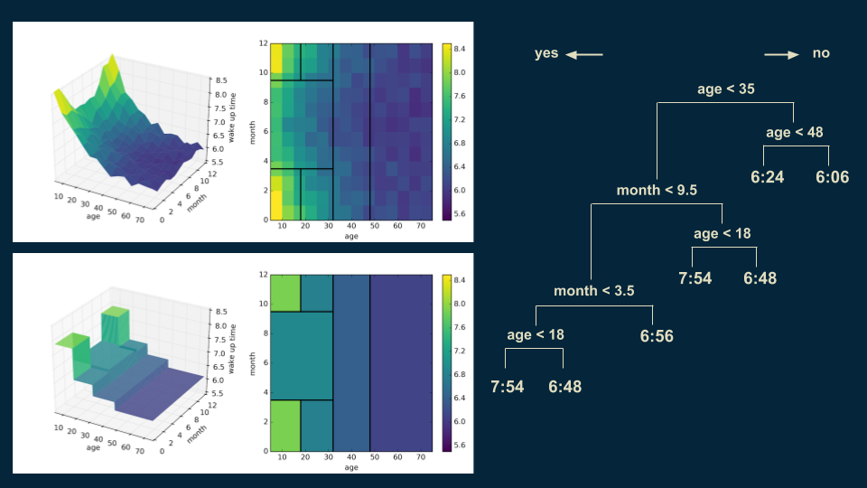
Notes:
We can also go back and subdivide our under 35 winter wake up times on age 18. Someone under 18 in the winter will wake up at 7:54, as opposed to 6:48 for those over 18.
As we make each additional cut, the shape of our decision tree model becomes a little bit closer to that of the original data. Also, you’ll notice in the upper right hand plot that the decision boundaries begin to slice the data set into regions of approximately uniform color.

Slide 29
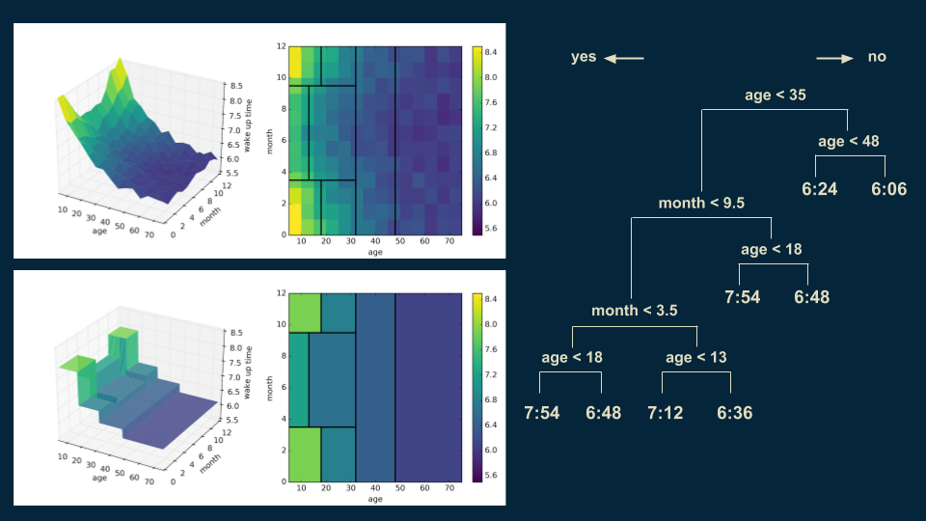
Notes:
We can also go back and subdivide our under 35 winter wake up times on age 18. Someone under 18 in the winter will wake up at 7:54, as opposed to 6:48 for those over 18.

Slide 30
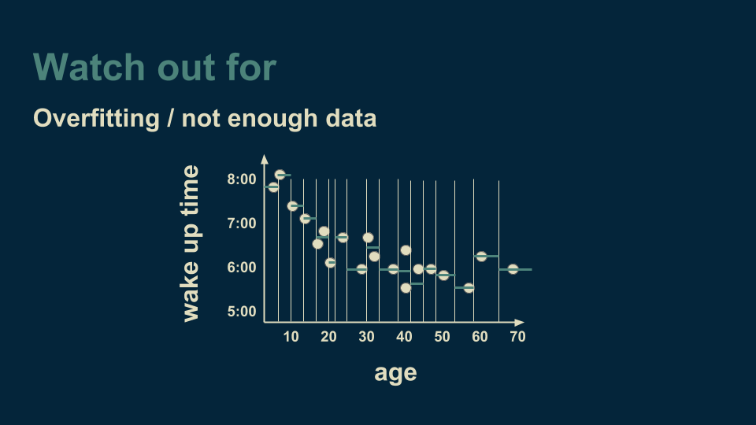
Notes:
An important one to watch out for is overfitting. Returning to our example of a single variable regression tree, age versus wake up time, imagine that we continued to make cuts on the age axis until there were only one or two data points in each bucket.

Slide 31
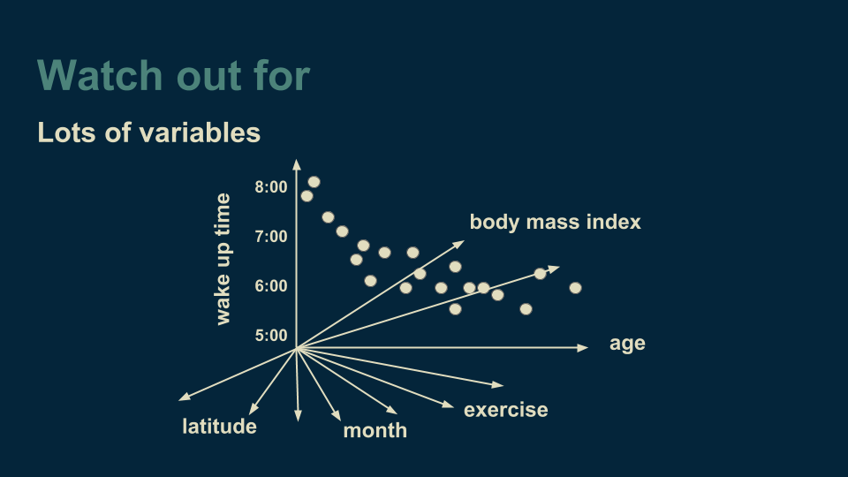

Slide 32
Decision Trees There are couple of algorithms there to build a decision tree , we only talk about a few which are CART (Classification and Regression Trees) → uses Gini Index(Classification) as metric. The Gini coefficient is a measure of inequality of a distribution Gini index is Gini Coefficient expressed as percentage ID3 (Iterative Dichotomiser 3) → uses Entropy function and Information gain as metrics.

Slide 33
Decision Trees Two variants: Random Forest XgBoost

Slide 34
Random Forest

Slide 35
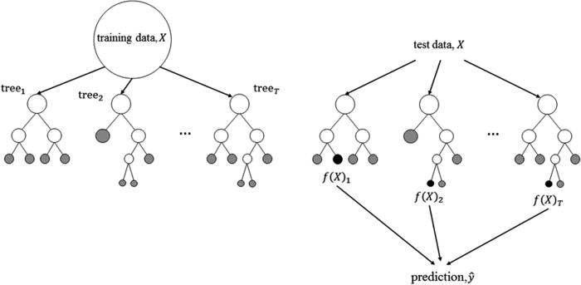

Slide 36
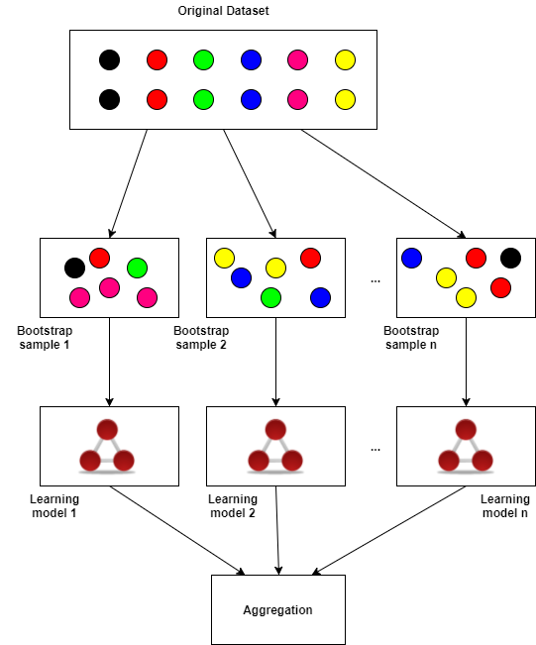
Bootstrap Aggregation, or bagging is a powerful technique that reduces model variances (overfitting) and improves the outcome of learning on limited sample (i.e. small number of observations)
Bagging works by taking the original dataset and creating M subsets each with n samples per subset. The n individual samples are uniformly sampled with replacement from the original dataset

Slide 37
Random forest — a way of bagging trees.
So what is bagging? Bagging is an interesting idea which is what if we created five different models each of which was only somewhat predictive but the models gave predictions that were not correlated with each other. That would mean that the five models would have profound different insights into the relationships in the data. If you took the average of those five models, you are effectively bringing in the insights from each of them. So this idea of averaging models is a technique for Ensembling.

Slide 38
XGBoost (Extreme Gradient Boosting)

Slide 39
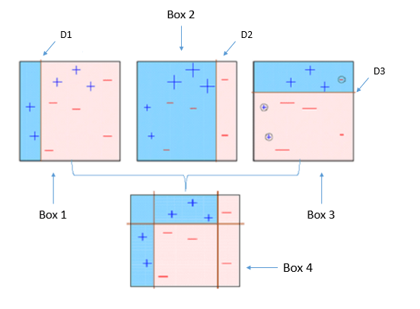
Boosting

Slide 40
Boosting
Box 1: The first classifier (usually a decision stump) creates a vertical line (split) at D1. It says anything to the left of D1 is + and anything to the right of D1 is -. However, this classifier misclassifies three + points.
Box 2: The second classifier gives more weight to the three + misclassified points (see the bigger size of +) and creates a vertical line at D2. Again it says, anything to the right of D2 is - and left is +. Still, it makes mistakes by incorrectly classifying three - points.
Box 3: Again, the third classifier gives more weight to the three - misclassified points and creates a horizontal line at D3. Still, this classifier fails to classify the points (in the circles) correctly.
Box 4: This is a weighted combination of the weak classifiers (Box 1,2 and 3). As you can see, it does a good job at classifying all the points correctly.
Notes:
That's the basic idea behind boosting algorithms is building a weak model, making conclusions about the various feature importance and parameters, and then using those conclusions to build a new, stronger model and capitalize on the misclassification error of the previous model and try to reduce it

Slide 41
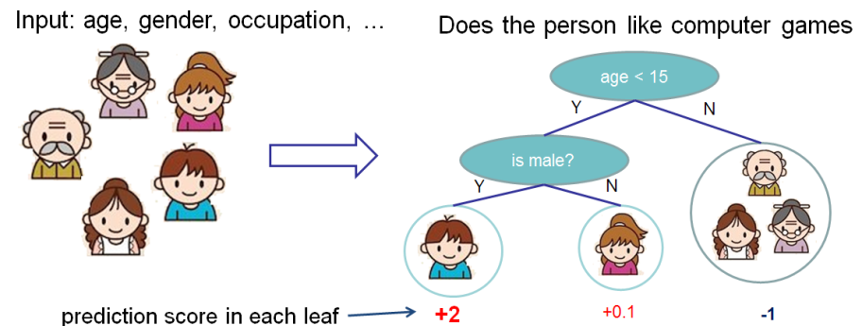
Decision Tree Ensembles
Notes:
https://xgboost.readthedocs.io/en/latest/tutorials/model.html

Slide 42
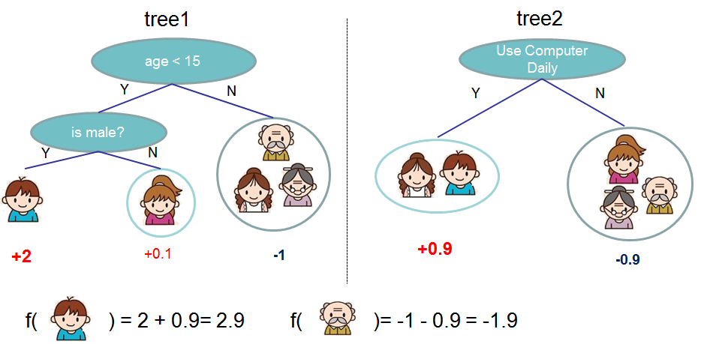
Decision Tree Ensembles
Notes:
https://xgboost.readthedocs.io/en/latest/tutorials/model.html

Slide 43
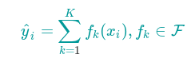
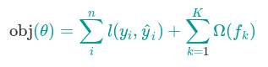
Decision Tree Boosting
Where, K is the number of trees, f is a function in functional space F, and F is set of all possible CARTs. The objective function to be optimized is given by:
Notes:
Now here comes a trick question: what is the model used in random forests? Tree ensembles! So random forests and boosted trees are really the same models; the difference arises from how we train them. This means that, if you write a predictive service for tree ensembles, you only need to write one and it should work for both random forests and gradient boosted trees
Training loss + regularization

Slide 44
Tree Boosting
Now that we introduced the model, let us turn to training: How should we learn the trees? The answer is, as is always for all supervised learning models: define an objective function and optimize it!
Let the following be the objective function (remember it always needs to contain training loss and regularization):
Notes:
https://xgboost.readthedocs.io/en/latest/tutorials/model.html

Slide 45
SVM

Slide 46
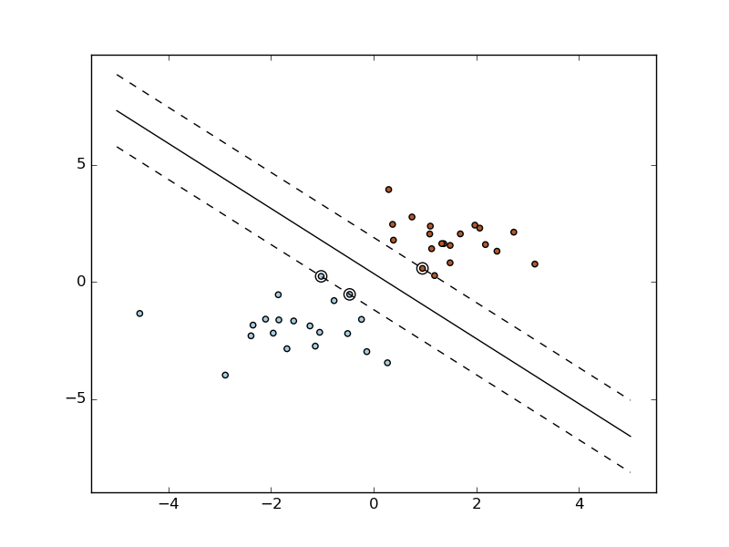
SVM: scikit learn docs

Slide 47
Example
A fruit is either
small or large and
yellow or purple.
A small yellow fruit is an unripe plum. It is not good to eat.
A small purple fruit is a ripe plum. It is good to eat.
A large yellow fruit is a ripe peach. It is good to eat.
A large purple fruit is a rotten peach. It is not good to eat.

Slide 48
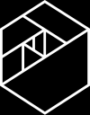
Example
large
ripe peach
rotten peach
yellow
purple
unripe plum
ripe plum
small

Slide 49
Example
peaches
yellow
purple

Slide 50
Example
peaches
yellow
purple

Slide 51
Example
peaches
yellow
purple

Slide 52
Example
peaches
yellow
purple

Slide 53
Example
peaches
yellow
purple

Slide 54
Example
peaches
yellow
purple

Slide 55
Example
large
yellow
purple
small

Slide 56
large
Example
large
yellow
purple
yellow
purple
small
small

Slide 57
Example
large
large
yellow
purple
yellow
purple
small
small

Slide 58
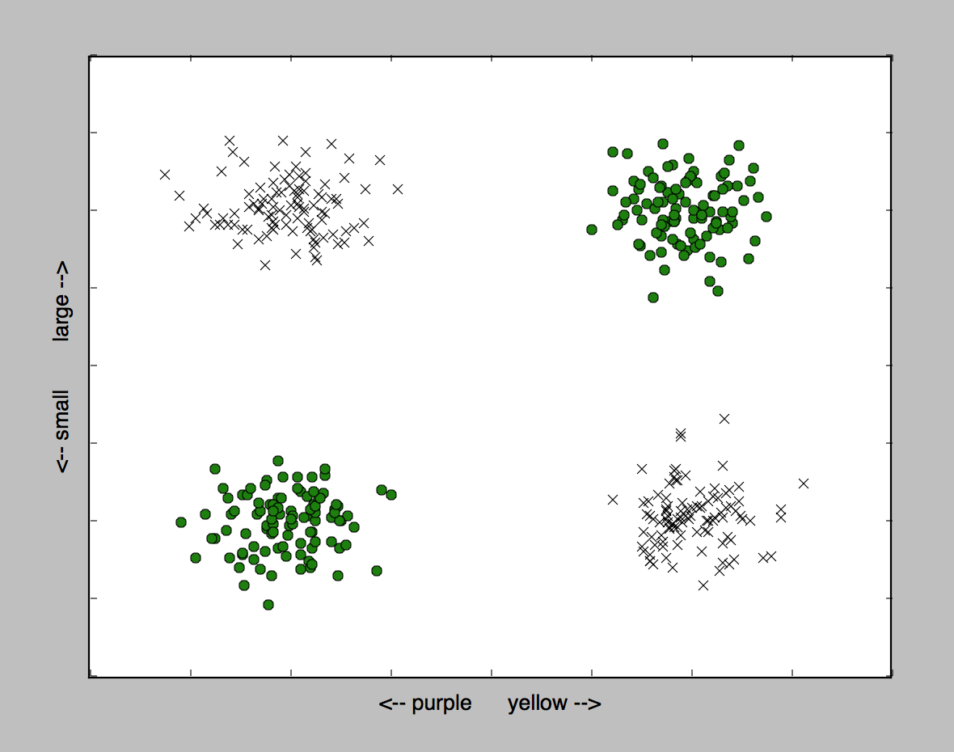
Example
large
large

Slide 59
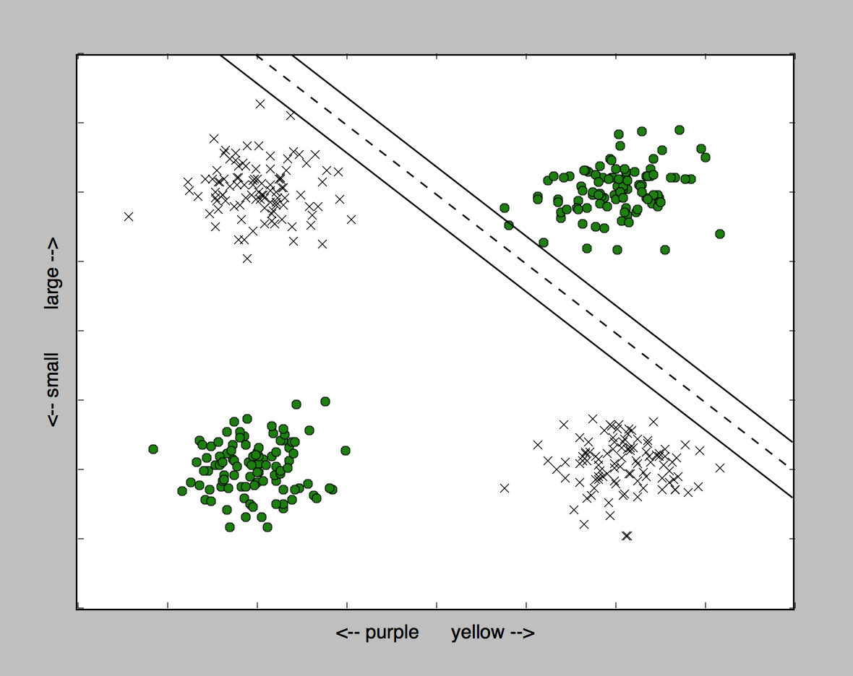
Example
large
large

Slide 60
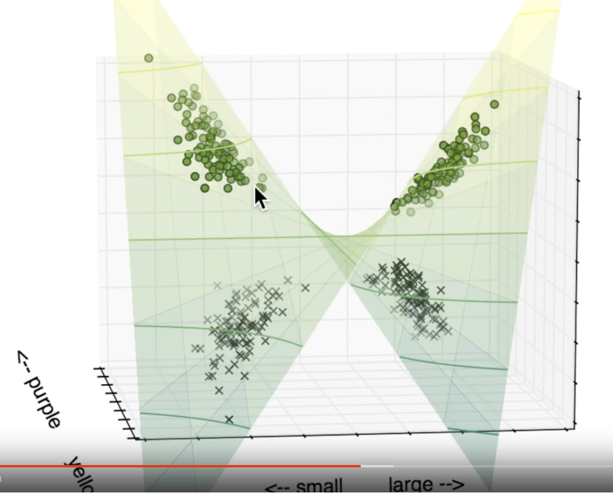
Example
large
large

Slide 61
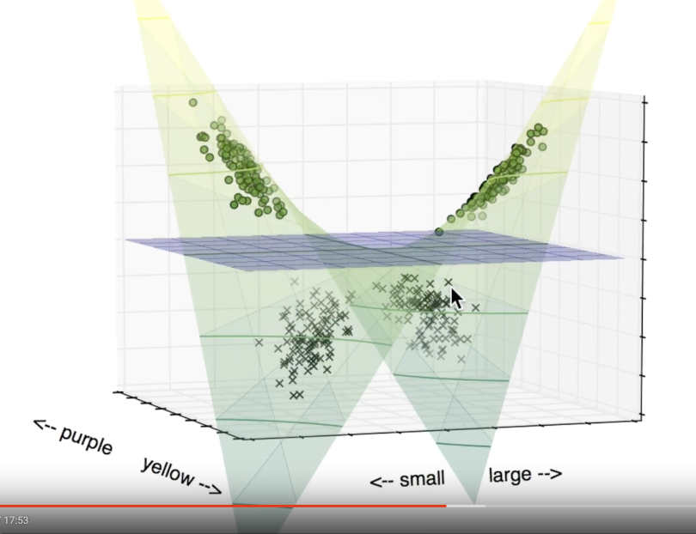
Example
large
large

Slide 62
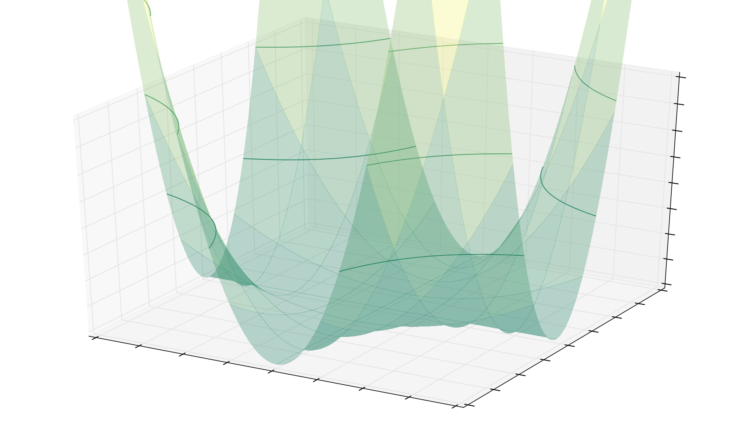
Example
large
large

Slide 63
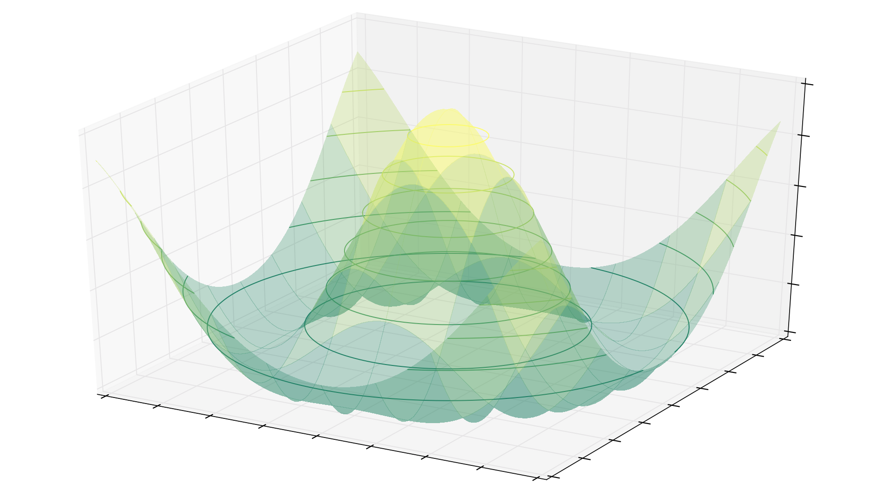
Example
large
large

Slide 64
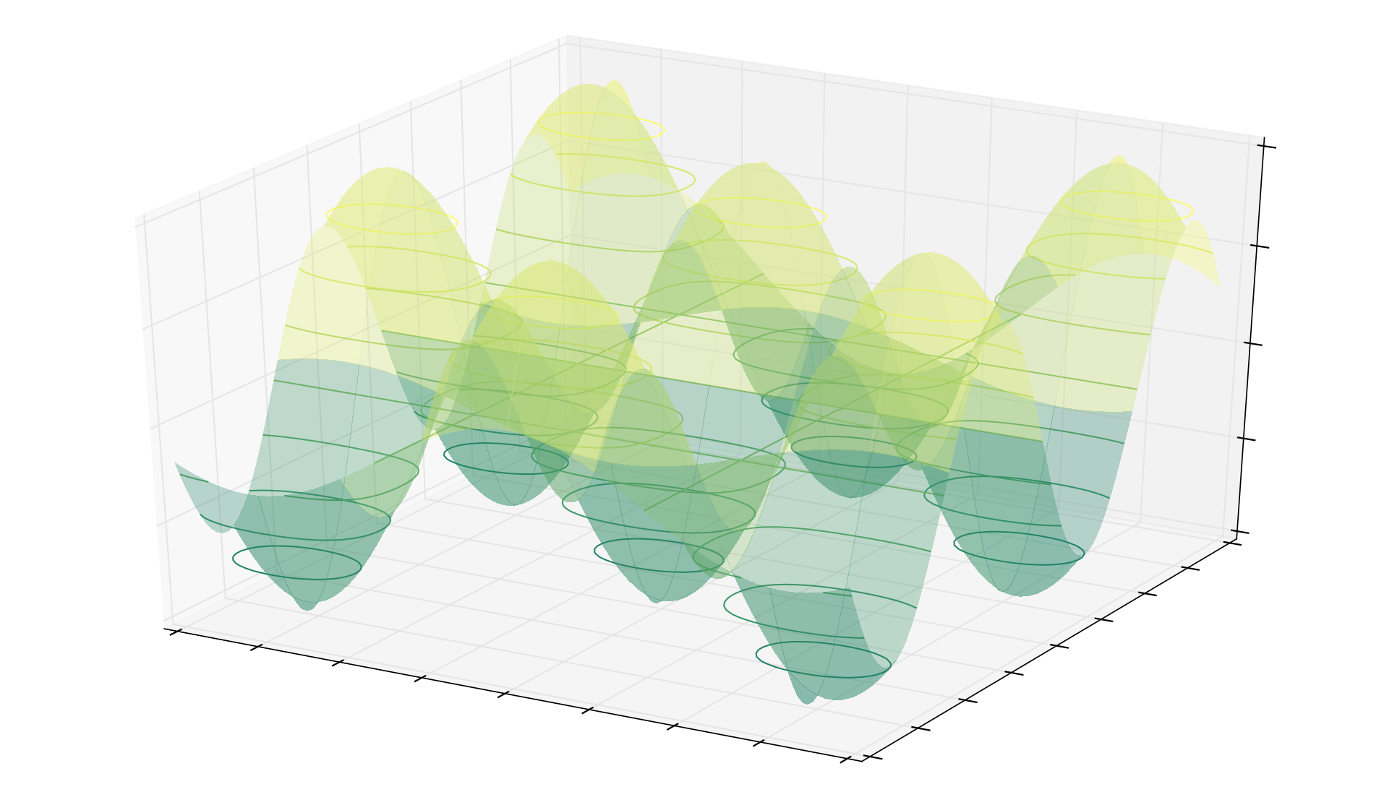
Example
large
large

Slide 65
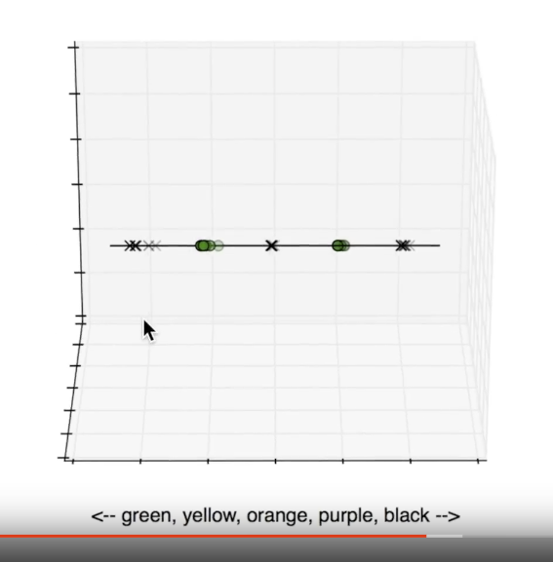
Example
large
large

Slide 66
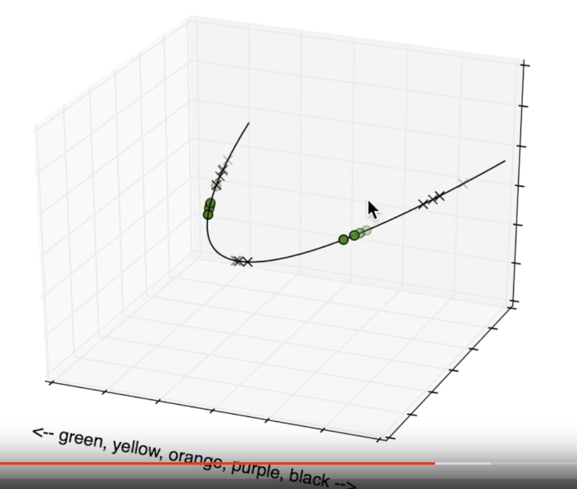
Example
large
large

Slide 67
Example
large
large

Slide 68
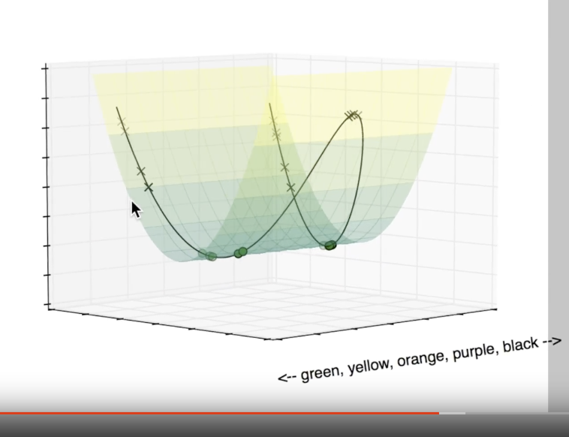
Example
large
large

Slide 69
Example
large
large

Slide 70
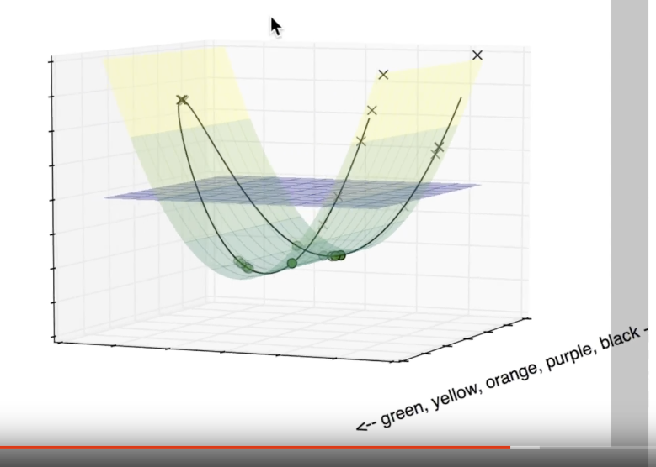
Example
large
large

Slide 71
SVM: Breaking Points
Data with lots of error.
Discriminator location depends entirely on the few nearest data points.
Choosing the wrong kernel.
Kernel selection is trial and error.
Large data sets.
Calculating the kernel is expensive.
Each of these requires a human in the loop to make judgment calls.

Slide 72
Naive Bayes

Slide 73
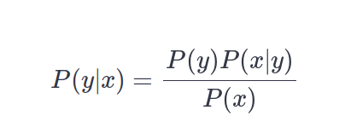
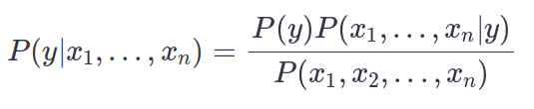
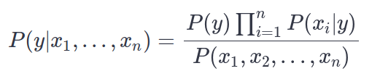
Let’s start with bayes theorem: (for naive bayes, x is the input and y is the output)
For more than one feature, we can write Baye’s theorem as:
Since, we are making the assumption that X_{i}’s are conditionally independent given y, we can rewrite the above as

Slide 74
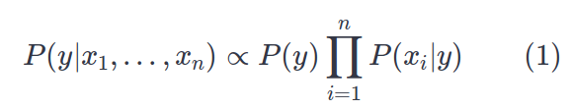
We also know that P(X1, X2, ……. Xn) is a constant given the input
LHS is the term we are interested in probability distribution of the output Y given input X
P(y) can be estimated by counting the number of times each class y appears in our training data (this is called Maximum a Posteriori estimation)
P(xi|y) can be estimated by counting the number of times each value of xi appears for each class y in our training data

Slide 75
Logistic Regression Don’t be confused by the term “Regression” it’s a classification algorithm (Variant of Linear Regression )

Slide 76
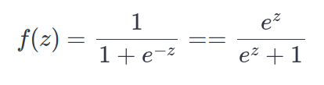
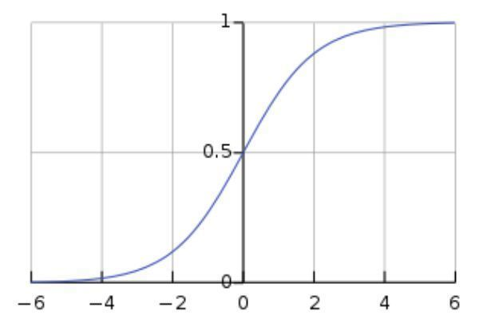
The logistic(or Sigmoid) Function

Slide 77
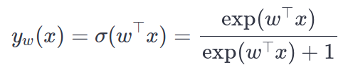
The sigmoid function squashes the input value between [0,1].
Since the range of output is between 0 and 1, we can interpret the output as a probability.
The logistic function also has the desirable property that it is a differentiable function. Hence, we can train the machine learning model using gradient descent
Logistic Regression Model (for binary classification)
In logistic regression, the output y_{w}(x) is squashed by a sigmoid function, i.e.

Slide 78
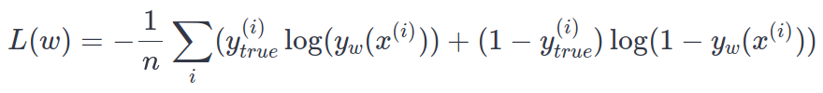
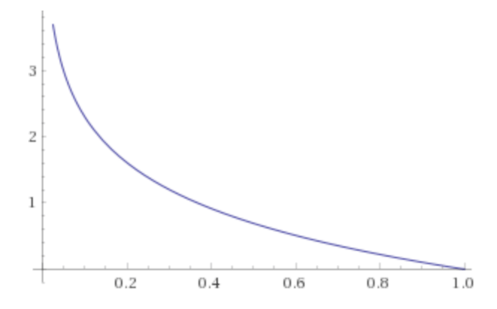
Cost Function
The figure is a plot of negative log probability. As we can see, this cost is high when the target class is assigned a low probability, and is 0 if the assigned probability is 1.

Slide 79
Training the model
We use gradient descent to optimize the model. In fact, the cost function above is chosen so that the gradients dL/dw we get are meaningful.
Notes:
In fact, if you do the algebra and derive the mathematical formula for the gradients (we'll skip this since the algebra is quite messy and doesn't add much to the conceptual knowledge), you'll find that the gradients are exactly the same as in linear regression (even though the predictions are not the same, and the cost is not the same). Roughly speaking, the log in the cost function 'undoes' the sigmoid function.

Slide 80
Neural Nets
Recurrent Neural Network
Used for Handwriting Recognition,Speech Recognition
Convolution Neural Network
Used for Images recognition, Images classifications. Objects detections,
Face recognition .

Slide 81
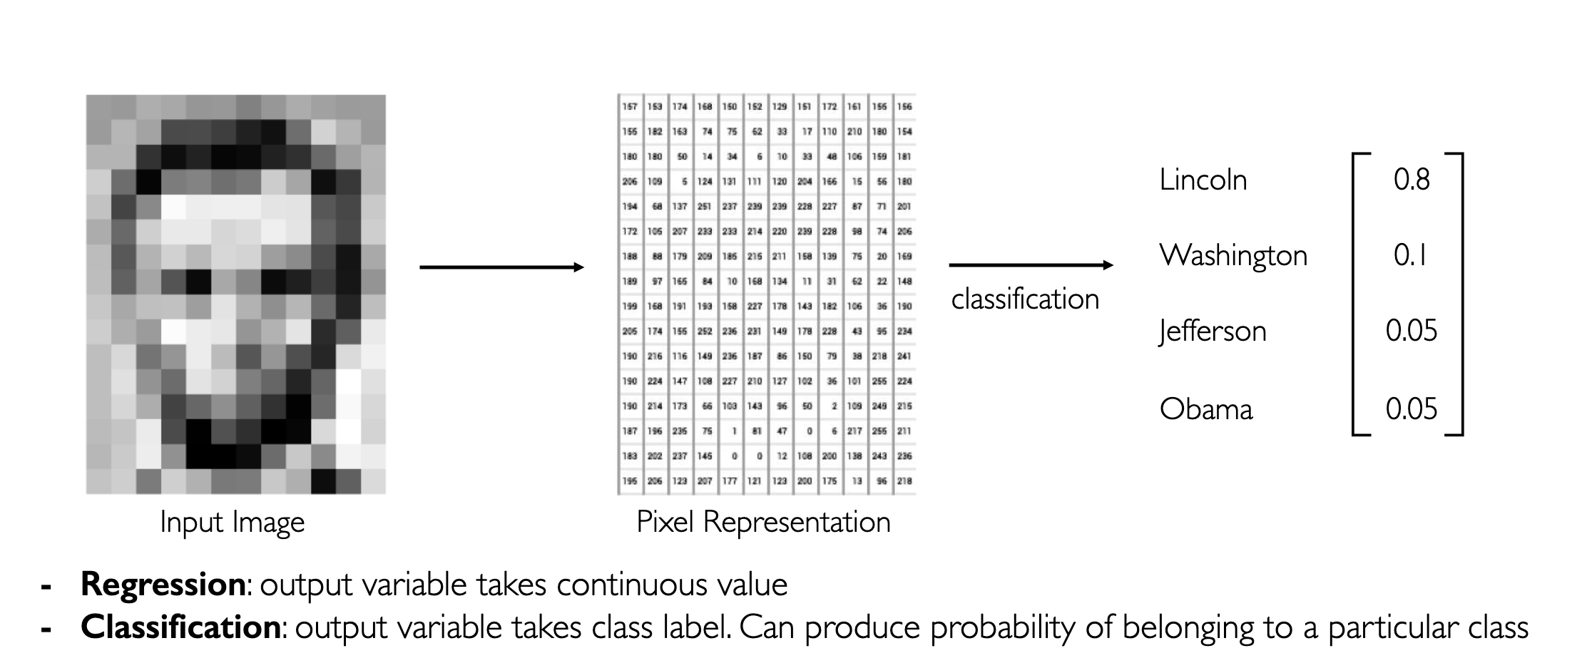
CNNs

Slide 82

CNNs

Slide 83

CNNs

Slide 84

CNNs

Slide 85

RNNs

Slide 86

RNNs

Slide 87

RNNs

Slide 88

RNNs

Slide 89

RNNs

Slide 90

RNNs

Slide 91
ThankYou
Survey: https://docs.google.com/forms/d/1nr6MZ7BVtG6lXmol4HevXTlcdFhCUxuTTWv_vtbbsTs/edit
?
Notes:
Any Questions ?

